Slide 1

ABE 715
Computer Programming
Lecture 14: Internet of Things (IoT) Integration
Connecting Physical Sensors to Digital Logic
Dr. Kadeghe G. Fue
Department of Agricultural Engineering
1

Slide 2

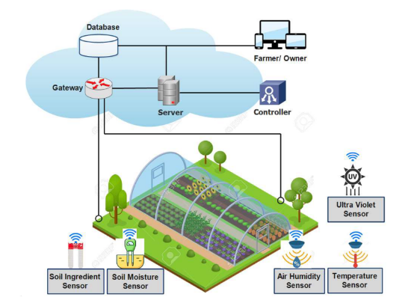
What is IoT?
The Connected Farm
The Internet of Things (IoT) refers to physical devices embedded with sensors and software that connect and exchange data with other devices over the internet.
•
Sensing: Collecting data (Soil Moisture, Temp).
•
Communication: Sending data (WiFi, LoRa, GSM).
•
Actuation: Doing work (Opening Valves).
2

Slide 3





The Architecture Stack
1. Edge Device
2. Connectivity
3. Cloud/Server
The hardware in the field.
Example: Arduino, ESP32, Raspberry Pi.
How data moves.
Example: MQTT, HTTP, LoRaWAN.
Where data is stored and processed.
Example: ThingSpeak, AWS IoT.
3

Slide 4

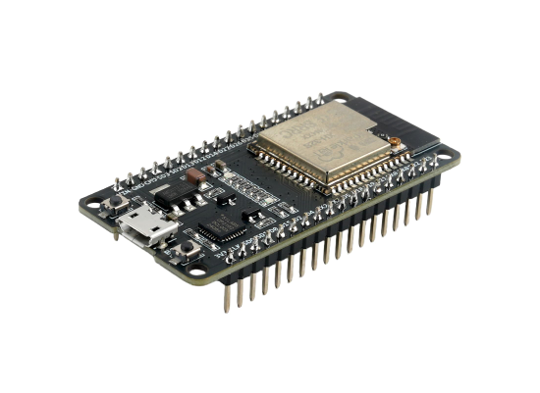
The Brains: Microcontrollers
ESP32 & Arduino
For this course, we focus on the ESP32.
•
WiFi & Bluetooth built-in.
•
Low Power: Can run on batteries/solar.
•
GPIO Pins: To connect sensors (Analog/Digital).
•
Programmable: Using C++ (Arduino IDE) or MicroPython.
4

Slide 5


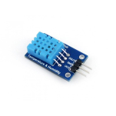
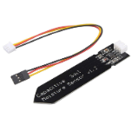
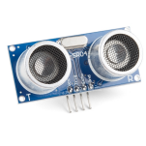
Common Agricultural Sensors
DHT11/22
Capacitive Soil
Ultrasonic
Measures Air Temperature and Humidity.
Measures Soil Moisture content (Analog Voltage).
Measures Water Level in tanks.
5

Slide 6
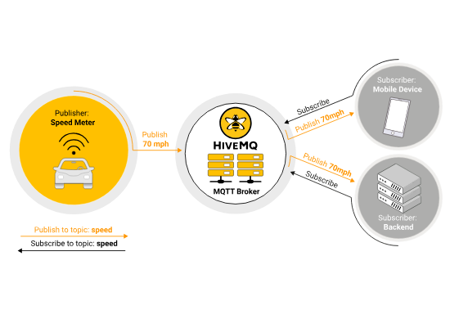
How Devices Talk: MQTT
MQTT (Message Queuing Telemetry Transport)
The standard for IoT. It is lightweight and works well on slow networks (like remote farms).
•
Publish/Subscribe Model:
○
Sensor Publishes to topic "farm/temp".
○
Dashboard Subscribes to topic "farm/temp".
•
Requires a Broker (Server) in the middle.
6

Slide 7
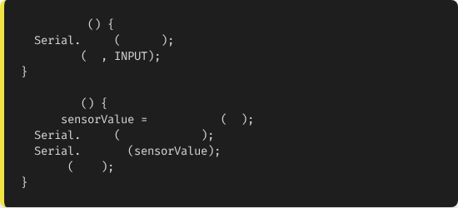
Coding for Hardware (C++)
void
setup
We typically use the Arduino IDE (C++).
begin
115200
pinMode
34
// Sensor Pin
The code has two main parts:
void
loop
int
analogRead
34
1.
setup(): Runs once. Initialize pins and WiFi.
print
"Moisture: "
println
2.
loop(): Runs forever. Read sensors and send data.
delay
1000
// Wait 1 sec
7

Slide 8
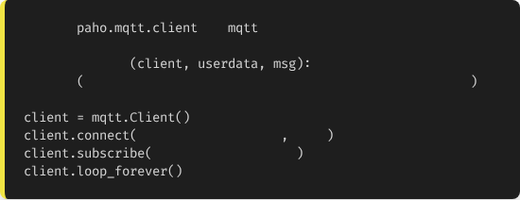
The Server Side: Python Listener
Receiving Data
import
as
We can write a Python script on our laptop (or server) to listen for the MQTT messages coming from the field.
def
on_message
print
f"Topic: {msg.topic}, Data: {msg.payload.decode()}"
"broker.hivemq.com"
1883
We use the paho-mqtt library.
"sua/farm/moisture"
8

Slide 9
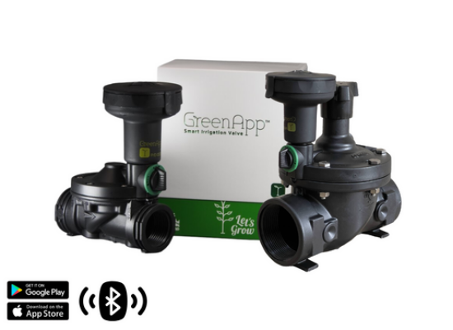
Case Study 1: Smart Irrigation
The Feedback Loop
1.
Sense: ESP32 reads Soil Moisture < 30%.
2.
Transmit: Sends alert to Server via MQTT.
3.
Decide: Python server checks weather forecast (API). No rain?
4.
Actuate: Server sends "OPEN_VALVE" command back to ESP32.
5.
Action: Relay opens the solenoid valve.
9

Slide 10
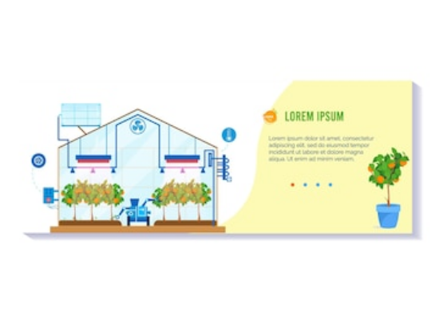
Case Study 2: Greenhouse Monitor
Environmental Control
Maintaining VPD (Vapor Pressure Deficit) is crucial.
•
Inputs: Temp & Humidity (DHT22).
•
Logic: Calculate VPD in Python.
•
Outputs: If VPD is high, turn on Misters. If Temp is high, turn on Exhaust Fans.
10

Slide 11



Challenges in the Field
Power
Connectivity
Harsh Environment
No outlets in a field. Need efficient solar panels and deep-sleep coding modes.
WiFi range is short. Farms often use LoRaWAN (Long Range) to transmit km away.
Heat, humidity, dust, and insects destroy electronics. Need IP67 enclosures.
11

Slide 12

Lecture 14: Take-Home Assignment
The IoT Dashboard
Scenario: Your ESP32 is sending temperature data to a public MQTT broker.
Topic: sua/abe715/temp
Task: Write a Python script using paho-mqtt and matplotlib to:
1.
Connect to the broker.
2.
Subscribe to the temperature topic.
3.
Collect 10 readings into a list.
4.
Once 10 readings are collected, automatically plot a Line Graph and save it as temp_log.png.
12

Slide 13
Questions?
Next Class: Final Project Presentations
Dr. Kadeghe G. Fue
Department of Agricultural Engineering
13

